Slide 1

LFG Made Easy

Slide 2

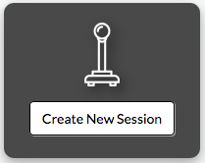
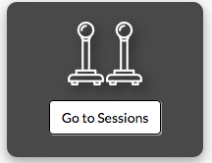
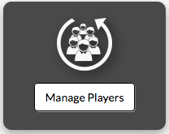
Create a New Session
Let everyone know what, when and how you are playing
See Who is Playing
Join others gaming sessions already in progress
Manage Profile
Create and manage a user profile with session stats

Slide 3





Sequelize
We used the Sequelize API to communicate and run our CRUD functionality on our webpage
MySQL
We are using a MySQL database with multiple tables in order to store all the pertinent Player and Session data.
HTML5, CSS3, JavaScript and Bootstrap
We used these languages and libraries to style our webpage.

Slide 4

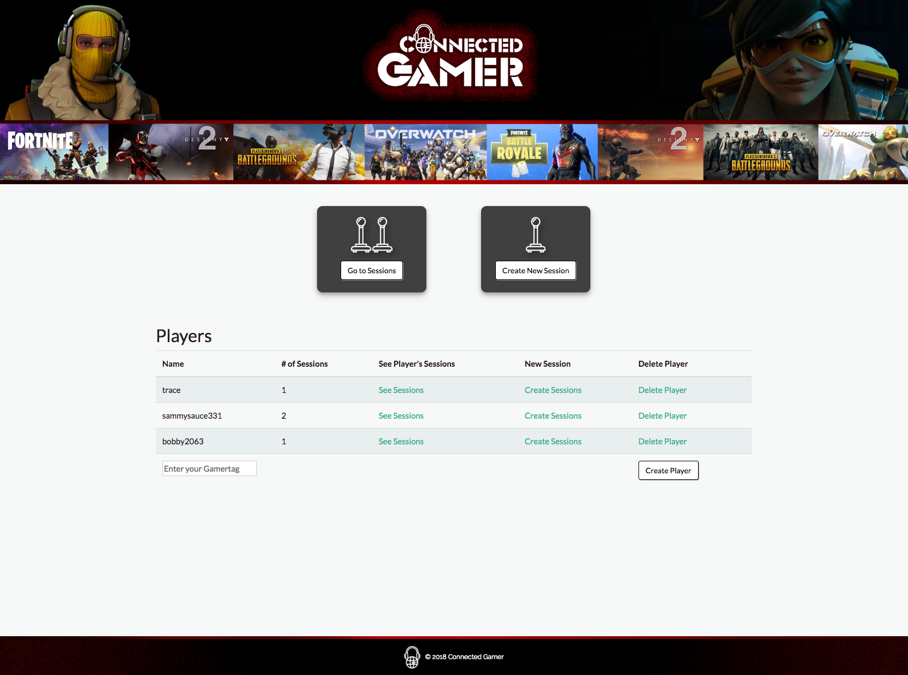
Create a profile
Use your gamertag or Screen name
from your favorite platform to get started!
No Login in this version, will be implemented in final version to streamline and personalize your experience.

Slide 5

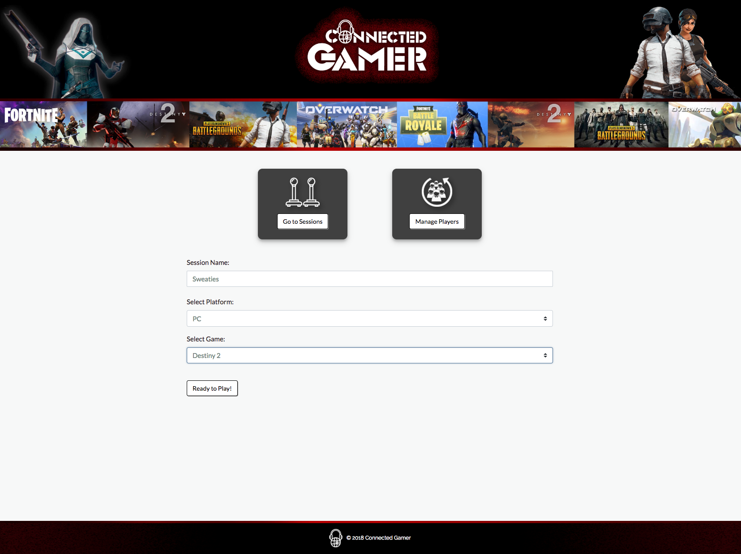
Start a session
Let everyone know what and how
you want to play!
Personalize your session name to set the mood.
Let the interested gamers come to you.

Slide 6

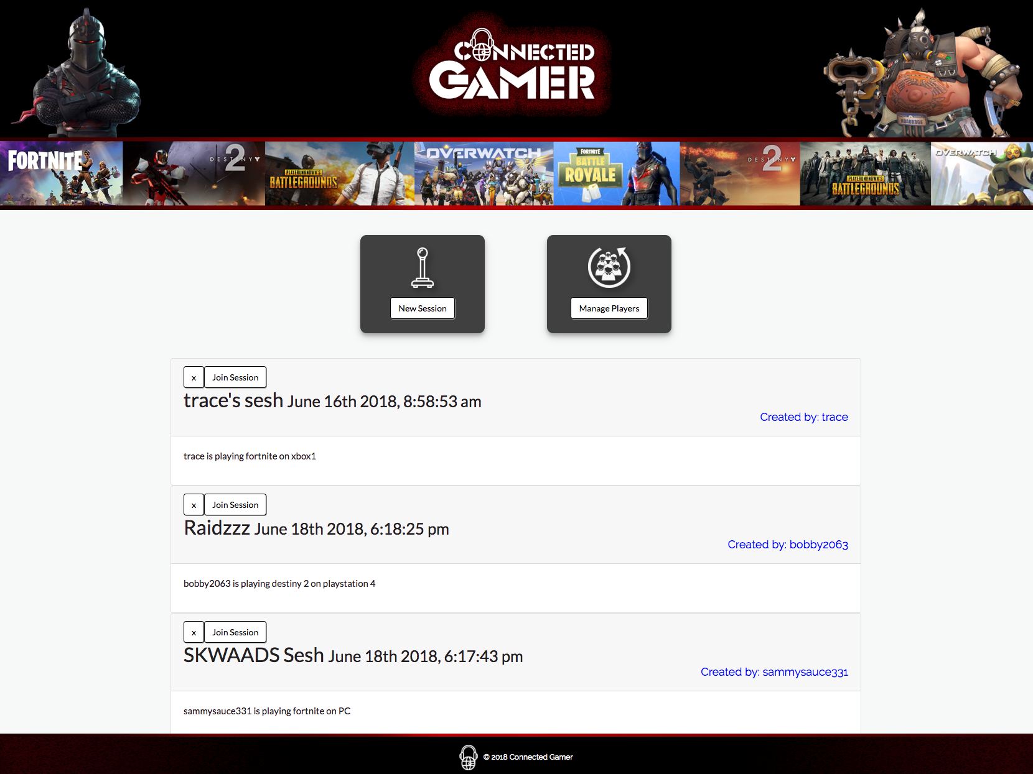
Let’s play!
Choose the game that fits you!
Curated list of session options!
Remove listings you’re not interested in.
Join session to get details on how to connect!

Slide 7

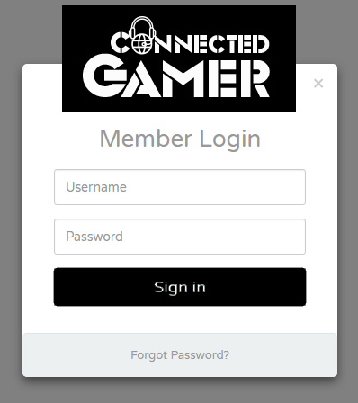
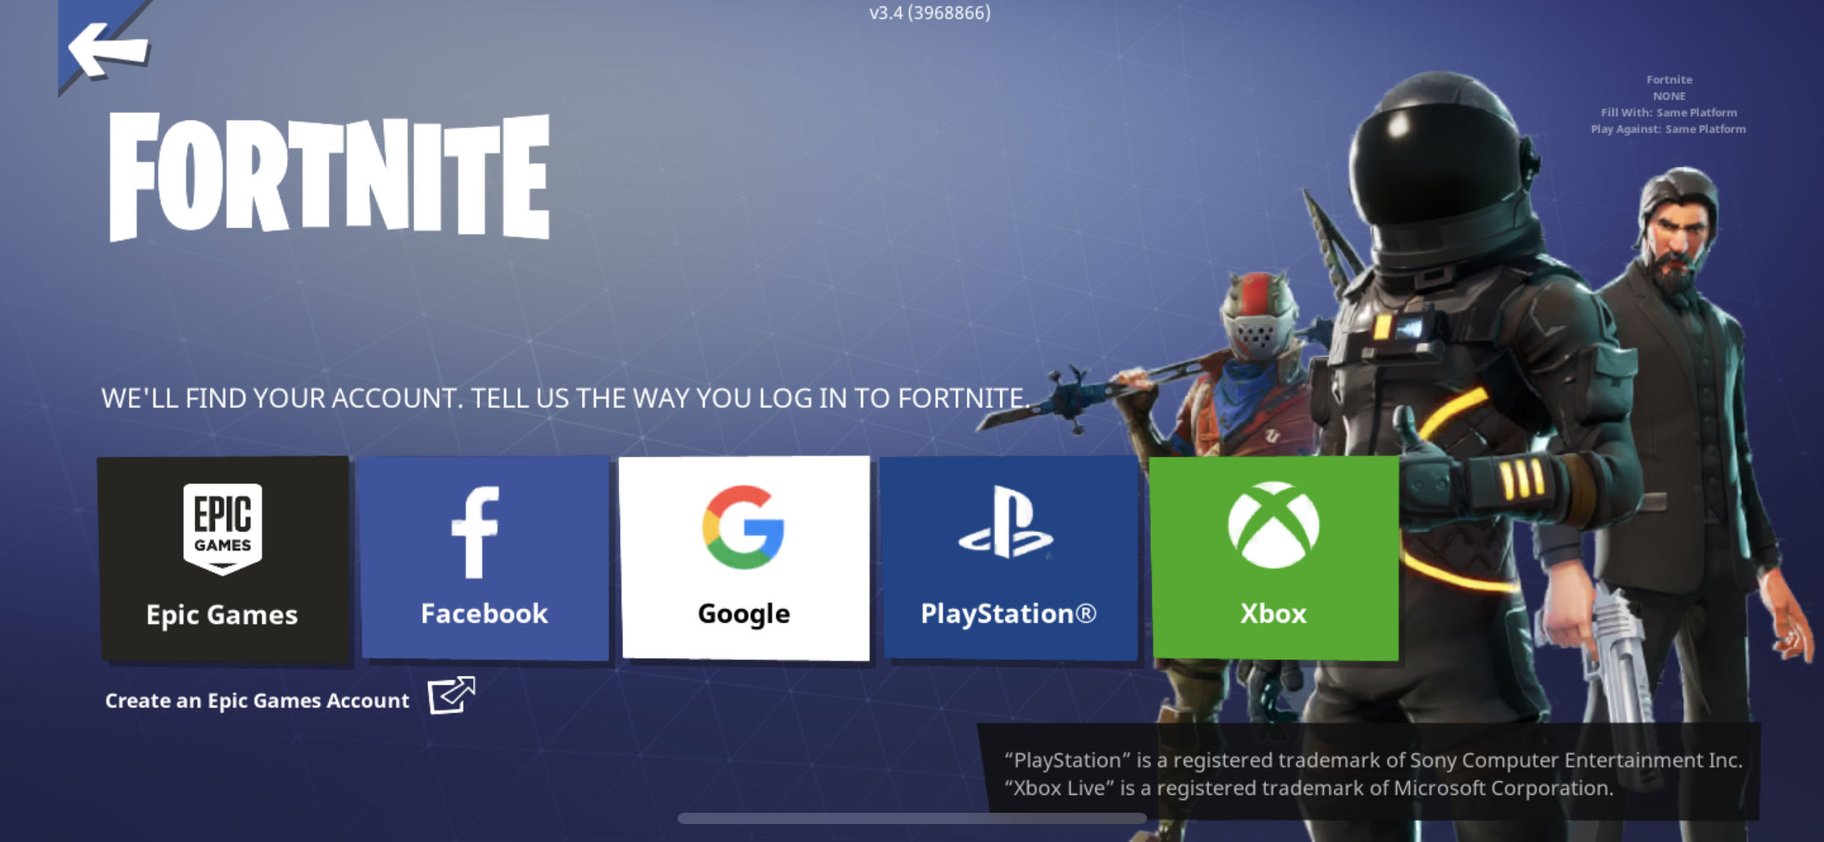

Login
User login will give you a more personalized experience and will stream line the process by learning your frequently used Platforms and games played.
Discord Integration
Give users a way to immediately be connected via the voice chat app, Discord.
Platform Login Integration
Use PSN, Xbox Live, or Steam login so that players can connect in game.

